Slide 1
Mobile Architecture and Security
Swapnil parashar

Slide 2
Overview
Mobile Application Architecture (15%)
Key mobile application components
Design considerations for mobile applications
Performance considerations
Architectural patterns and design patterns applicable to mobile solutions
Implementation technologies.

Slide 3
Module Assessment Strategy
Allocation of marks
Terminal Exam 50% - end of semester
Project 50% - week 9
Total 100%

Slide 4
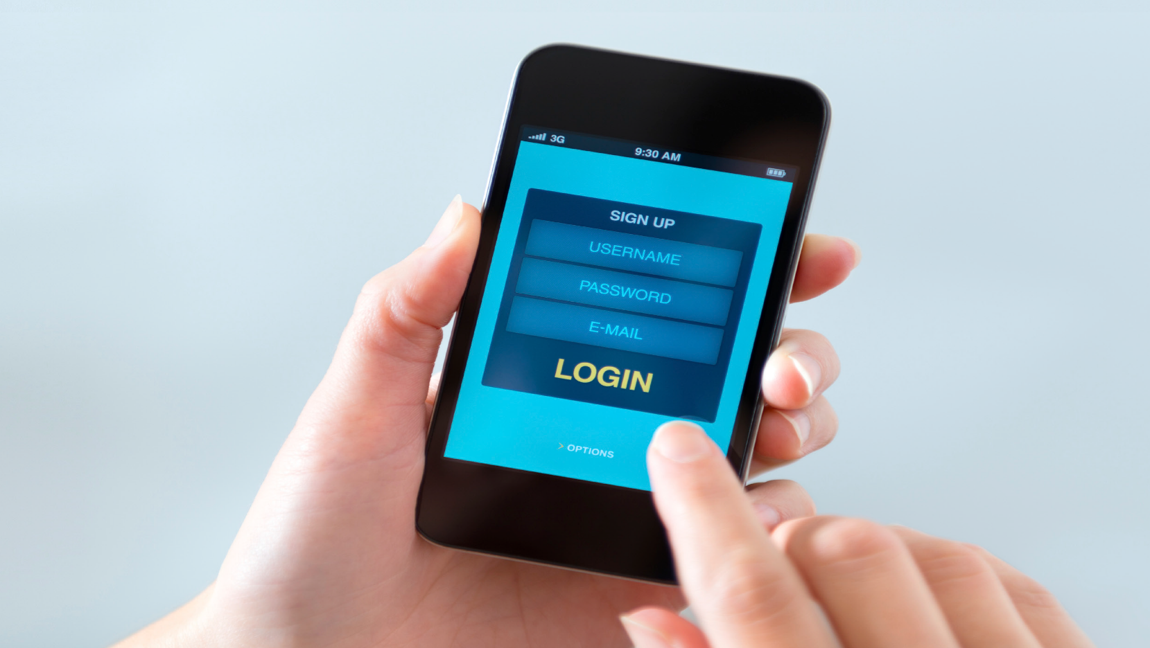
Delivering Secured Mobile Solutions

Slide 5
Main Threats
There are three main targets for threats – information, identity, and availability.
A mobile device is personal, and is used for both private and business productivity even more in the context of a Bring Your Own Device (BYOD) company scenario. Devices store valuable and sensitive information. Keeping that information secure is vital. The consequences of a malicious third party
gaining access to personal financial information, for example, could be disastrous and irreparable. With mobile devices gathering personal, often photographic, information about where the owner lives, works and spends his or her leisure time, the consequences of a mobile device getting into the wrong hands could be truly catastrophic. And with devices being used for work and leisure, the possibility of sensitive business information getting into the wrong hands could have much, much wider – and potentially massive – implications.
Moreover, the major new challenge to security is that information is now scattered rather than being centrally stored. For this reason, rather than being on the datacenter, security must now be on the transport medium and the information itself. Addressing the linked, unprecedented security challenges of scattered information being accessed and exchanged via mobile devices is the subject of this point of view.

Slide 6
A Structured Approach to Mobile Security
Several aspects must be considered when working with mobile security and apps
Confidentiality: Does the app keep private data private?
Integrity: Can data passed to and from the app be trusted and verified?
Authentication: Does the app verify the user’s identity to an appropriate degree of certainty?
Authorization: Does the app properly limit user privileges?
Availability: Can an attacker harm the mobile solution in any way?
Non-Repudiation: Does your app keep records of events?

Slide 7
Mobile Security Lifecycle
A structured approach to working with mobile security is to define mobile security architecture with the following lifecycle
Design
Manage
Implement

Slide 8
Mobile Security Lifecycle
The lifecycle begins with the design of the mobile security architecture, and consists of a structured process that defines the contextual, conceptual, logical, and physical architectures for mobile security. It starts by defining the business requirements for mobile security in a contextual mobile security architecture, which is refined all the way down to the physical level.
The physical mobile security architecture defines the actual products and technologies used to implement the mobile security architecture. This is the lifecycle’s second phase. It includes elements such as selecting mobile platforms, system design of mobile apps, handling secure access to data,
secure transfer of data, secure storage of data, testing mobile security, as well as managing devices and apps.
The last, and probably most important, phase of the lifecycle defines how to manage the mobile security architecture over time. This involves keeping up to date on threats, improving implementation based on a changing technology landscape and best practices.

Slide 9
Designing a Mobile Security Architecture
Designing a secure corporate mobile environment can be done in four steps. We can summarize the whole process by giving an answer to the following questions:
• Why do we need to design a secure architecture for mobility? – Security principles and drivers for mobility
• What do we need to protect? –Assets to be protected.
People involved.
• How do we protect the mobile environment? – Functions needed to achieve security.
• With what do we implement? – The physical aspects of mobile security such as material and location.

Slide 10
Designing a Mobile Security Architecture
• WHY? The Contextual Mobile Security Architecture
The contextual architecture takes in input from the business requirements and all the constraints (policies, guidance, legal, regulation) as well as assumptions. It will then define a clear and shared view on the scope and the principles that will drive the secure mobile architecture. This means there is ultimately
a focus on data and application level security instead of relying only on network security only.

Slide 11
Designing a Mobile Security Architecture
• WHAT? The Conceptual Mobile Security Architecture
The conceptual security architecture aims to identify the security requirements. The way to identify security requirements is mainly to perform a risk assessment; what are the most significant threats and consequently what are
the security services that must be implemented to reduce the corresponding risks.

Slide 12
Designing a Mobile Security Architecture
• HOW? The Logical Mobile Security Architecture
This logical architecture intends to provide a logical model which delivers the security services while conforming to the principles and models as set out in the Contextual
Architecture and the Conceptual Mobile Security Architecture. The purpose of the Logical Security Architecture is to communicate how security should be implemented.

Slide 13
Designing a Mobile Security Architecture
• WITH WHAT? The Physical Mobile Security Architecture
The physical architecture is the selection of technologies and products that will be used to implement the Logical Mobile Security Architecture patterns defined in the step before

Slide 14
Implementing Mobile Security
Having established the approach of creating a mobile security architecture in a structured way, it’s vital to look at the concrete challenges that need to be dealt with. The most important areas are:
• Mobile Platforms: Evaluate security considerations for iOS, Android, and Windows Phone
• Mobile Apps, websites, and architecture: Security for apps, websites accessed from mobile browsers, and the important role of a solid software architecture
• Access Control: Select an authentication mechanism
• Data in Transit: Choose how to encrypt data communication
• Data at Rest: Set up secure data storage and containerization
• Mobile Testing: Test the security aspects (confidentiality, integrity, etc.) of the mobile solution
• Mobile Enterprise Platforms: managing mobile devices, apps, and content in a secure way.

Slide 15
Mobile Platforms
Several mobile operating systems drive millions of applications on billions of devices.
Android is the only operating system built on open source. Its open nature, spread across multiple device manufacturers, means that manufacturers should have the policy to distribute updates at the required frequency, which is not always the case4.
For this reason, security holes on Android devices can be left unpatched for a long time. The closed source code models of iOS and Windows Phone tend to update all devices within a matter of weeks of updates being available5, thereby quickly fixing security issues.
Regarding mobile application distribution, all three operating systems (Android, iOS, Windows 10) have app stores with a built-in aim of preventing the downloading of malicious software (malware). In the
iOS App Store and Windows Phone Store, each app will go through an approval process before they are made available to users, making it significantly harder for malware to be spread. There was no such rigorous process for Android apps in Google’s Play Store, but it has changed now. High risk apps are removed but the risk of distributing apps tainted with malware is clearly higher with Android devices. The fact that it’s even possible to install apps not distributed through Google Play, further increases that risk. Windows Phone and iOS don’t allow distribution of apps from outside their own app stores except in very specific enterprise cases.

Slide 16
Mobile Apps, Websites, and Architecture
There are two main ways to deliver content and functionality to mobile devices: via mobile apps or via websites that are viewed through a web browser.
The majority of apps available are written in a programming language that is platform-specific. All are compiled into a binary executable file that is made to download and run
entirely on each specific platform. These are generally referred to as native apps. However, most of these apps also include some web content and functionality that is either distributed with the app or accessed in real-time from a web server through a native component (often called a web view). Such apps are referred to as hybrid apps. The parts of a native app that consist of web content and functionality have the same security risks as any web site run in the browser

Slide 17
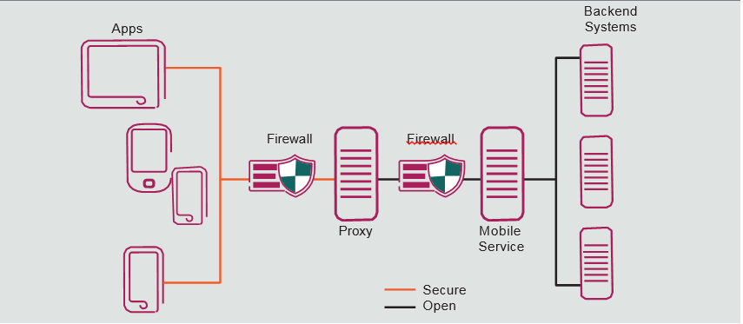
Mobile Apps, Websites, and Architecture

Slide 18
Mobile Apps, Websites, and Architecture
The fact that developers of native (and hybrid) apps have full control of the functionality implemented is both a security risk and an opportunity. Therefore, any organizations implementing these kinds of apps need to outline software architectural and coding guidelines that focus on mobile security issues and recommendations.
For example, a solid software architecture would consider a mobile (or multi-channel) service on the intranet that is made accessible in a secure way (e.g. via SSL and Basic Authentication) from the Internet through a reverse proxy. That way none of the backend systems are exposed directly, and the integrations are made easier in a secure environment (the intranet).
The security considerations for websites accessed through the browser on a mobile device are mostly the same as for any web application, and include risks such as cross-site scripting and request forgery, broken access control, file inclusion
and creation, and various types of injection (SQL, command, scripting, etc). There are also some specific mobile security risks that relate to the form factor, such as smaller screens.
For example, the URL is often abbreviated, preventing the user from knowing what site is actually accessed and any mobile browser specific security flaws.
The best general advice is to include mobile browsers on the most important platforms when designing, implementing, and testing websites for both customers and employees

Slide 19
Access Control

Slide 20
Access Control
Depending on the nature of the enterprise there are several established means of authenticating users. Many systems authenticate users via username and password. Others use one-time passwords.
Once a user is logged in there is normally policy around how long they can remain logged in before the session expires. This traditional approach may not be ideal for mobile.
In deciding to use a native (or hybrid) app, certain things must be considered:
• Must the user enter their username and password each time they use the application or can it be remembered?
• How long should a session last?
• Must users enter their credentials every time the device is unlocked or resumes from sleep?
• If the password is invalid what should be done with data on the device?

Slide 21
Access Control
How these questions are answered will inform the organization’s security needs as well as impact the user experience. It will be necessary to strike a balance between security and user experience based on needs. It is important to assess the risks being created by providing a better
user experience.
Instead of requiring the username and password every time, consider a design that uses an alternative password solely for the mobile app. For example, the user might first log in using their username and password, they would then generate a short, four digit PIN to access the application in future. Although this password itself is less secure than a normal password it can be designed to work only from that one mobile device and through no other service and can be revoked if the device is compromised without inconveniencing the whole account.

Slide 22
Access Control
Two-factor authentication (TFA) for apps might be considered. Popular with online banking and corporate VPN applications, this is where, in addition to a password or PIN, a user has a separate device that generates a one-time password. It is ideal in areas requiring extra security. As near-field- communication (NFC) becomes more popular there are possibilities to develop TFA solutions using NFC rather than one-time passwords. Such authentication will always be more secure but it requires users to carry another item of technology. What impact would this have on users and would it limit people wanting to use the app?
Associated to authentication are user interface and spyware issues. By essence, mobile apps are used in public spaces with surrounding people who may not be known to the user. Warding against the curious or malicious onlooker, the recommendation would be to design a secure Graphical User Interface that uses a random numeric keypad, or ensures a password is not displayed in clear text. It is also recommended to equip corporate smartphones with a privacy screen filter.
The key to any decisions around authentication involves trade-offs between user experience and risk. The more layers of complexity are added the more risk of frustrating the user. What is being stored on the device? And if it were compromised how will this impact the enterprise’s business? Is the act of creating a more secure authentication system due to perceived rather than actual risks? Once these issues are understood it will be possible to select the most suitable authentication mechanism. This may vary from app to app and from internal to external user depending on the overall mobile strategy.

Slide 23
Access Control
Internet access control and interface blockage issues must also be addressed. These issues cannot be covered in detail within this paper but will include how to address direct access authorization, prohibition of split tunneling, and compulsory use of company Internet access.
One way to avoid counterproductive employee activity, for example, is to establish a company policy that requires users to agree that when a device is being used for work, it will be on the company network. If those employees know they must use the company’s wireless network, they will be more inclined to keep activities to company policy.

Slide 24
Data in Transit
There are three main ways to securely transmit data to mobile devices: VPN, SSL, or custom encryption using third party or bespoke solutions. VPNs are the known and standard way to secure sensitive data transmission for employees within an organization that requires access from a remote site. In most organizations they are used to access internal systems and are designed for traditional, not mobile, computing applications.
Although VPNs can be used for mobile devices there are a number of drawbacks (unreliable and slow over 2G/3G connections, significant configuration overhead, poor user experience, etc).

Slide 25
Data in Transit
Ideally, a mobile security strategy that works for both internal and external users and that complements the mobile experience should be designed. The most popular way to secure data in transport from the physical connection is to use HTTPS (secure HTTP or SSL, more correctly referred to as TLS).
The technology is tried and trusted and for all but the most secure data, when twinned with suitable authentication and access control mechanisms, offers a high level of security.

Slide 26
Data in transit

Slide 27
Data in Transit
There are two approaches to bespoke encryption if there is a question of whether or not HTTPS will provide sufficient encryption. Transmitting all data with bespoke encryption
will necessitate writing a native (or hybrid) application to take advantage of the device’s capabilities. Investing in bespoke encryption can be both time-consuming and risky. Without a suitable strategy around key exchange and storage, there is a risk of data being less secure than if SSL is used.
If there is a willingness to invest in third party components, security frameworks and mobile enterprise application platforms (MEAPs) exist that can deliver high levels of security. Some of these have received FIPS 140-2 accreditation in the USA and similar levels elsewhere. There are many third party options to consider. Some are capable of securing data at rest, as well as data in transit.

Slide 28
Data at Rest
In a native (or hybrid) app, consideration must be given to what is done with any data that is downloaded. It can be stored on the device’s internal storage but that obviously poses a security risk. To store data securely requires it to be encrypted. There are two ways to do this: either relying on the device’s built in encryption systems or by using some form of bespoke or third party encryption technology within the application.
It may be necessary to store many details: usernames, passwords, authentication tokens, encryption keys and personal data related to the user or the organization.
Taking additional precautions to protect access to anything stored and data backup is prudent. Depending on the level of security needed there are several approaches.

Slide 29
Data at Rest
Most mobile operating systems support some form of device encryption – this is operating system data protection. Android, iOS and Windows Phone all operate with full disk encryption, similar to that employed on laptops. The entire device is encrypted when it is not being used, offering great protection for stolen devices being cracked but none from malware on the device itself. These forms of encryption tend to rely on the user’s device PIN, but if the PIN is a simple four-digit number
it is often possible to decrypt the data forensically in a matter of minutes10. Requiring longer, more complex alphanumeric passwords has been proven to be secure11. The information being stored on the device will determine whether these forms of encryption are sufficient, but what if a device is lost or stolen? It may be possible to wipe a corporate device, using a mobile device management (MDM) system to protect the data, but what wider impact would occur if a customer’s device were stolen?
If these standard operating system levels of protection are insufficient, it may be necessary to consider third party or custom solutions to encryption. This can be baked into the development process. The ultimate level of security can be obtained by using a secure container on the device where sensitive information is stored separately from the standard OS data on the device, even being protected in the case of a jailbreak or rooting.

Slide 30
Data at Rest

